Slide 1

ECE 2700
Digital Circuits
Latches &
Flip-Flops
Copyright © 2010 Frank Vahid
Instructors of courses requiring Vahid's Digital Design textbook (published by John Wiley and Sons) have permission to modify and use these slides for customary course-related activities, subject to keeping this copyright notice in place and unmodified. These slides may be posted as unanimated pdf versions on publicly-accessible course websites.. PowerPoint source (or pdf with animations) may not be posted to publicly-accessible websites, but may be posted for students on internal protected sites or distributed directly to students by other electronic means. Instructors may make printouts of the slides available to students for a reasonable photocopying charge, without incurring royalties. Any other use requires explicit permission. Instructors may obtain PowerPoint source or obtain special use permissions from Wiley – see http://www.ddvahid.com for information.

Slide 2
Today’s Objectives
To understand why latches are not suitable for data storage in a digital system
To become familiar with flip-flops and how they address the shortcomings of latches
To understand how to design and use a basic register

Slide 3
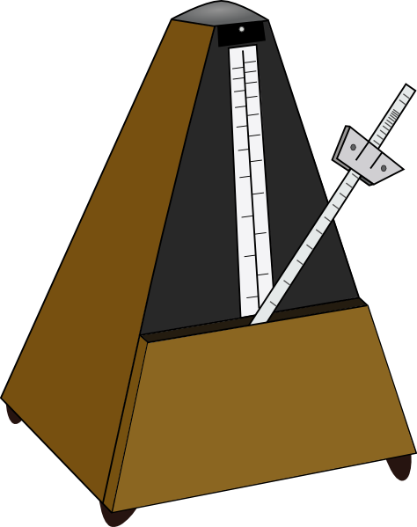
Clock
In digital systems, a clock provides a sequence of pulses
  This sequence of pulses tells components when to do things
D
Q
’
C
Q
+
Clock
D
Q
’
C
Q
D
Q
’
C
Q

Slide 4

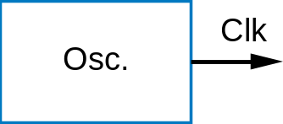
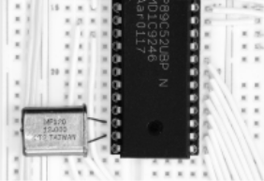
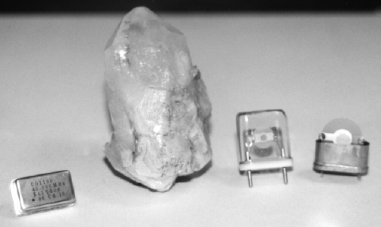
Clock Signal
1
Conceptually,
Implementation
Clk
0
Time
:
0 ns
10 ns
20 ns
30 ns
40 ns
50 ns
60 ns
0
1
0
1
0
1
0
Clk
Quartz crystal
Vibration with precise frequency
Current

Slide 5
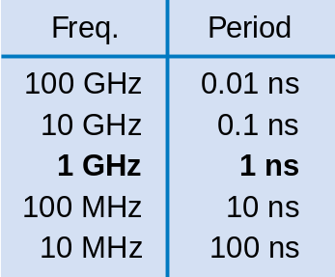
Oscillator
Generates periodic pulsing signal
Above:
  Period = 20 ns
  Frequency = 1/20 ns = 50 MHz
  Number of cycles = 3.5
1
Clk
0
Time
:
0 ns
10 ns
20 ns
30 ns
40 ns
50 ns
60 ns
0
1
0
1
0
1
0
1 GHz = 10⁹ cycles/s | 1ns = 10⁻⁹ s
1 MHz = 10⁶ cycles/s | 1μs = 10⁻⁶ s
1 kHz = 10³ cycles/s | 1ms = 10⁻³ s

Slide 6
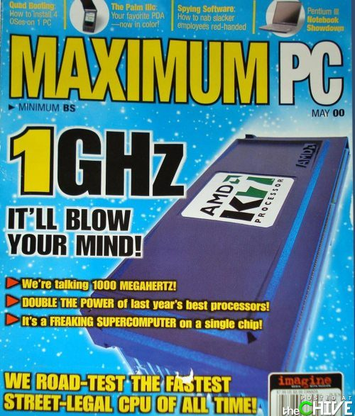

Slide 7
Question (AP)
What’s the clock period for the clock frequency of 3.4GHz?
  3.4ns
  0.34ns
  2.9ns
  0.29ns
  None of the above
1 GHz = 10⁹ cycles/s | 1ns = 10⁻⁹ s
1 MHz = 10⁶ cycles/s | 1μs = 10⁻⁶ s
1 kHz = 10³ cycles/s | 1ms = 10⁻³ s

Slide 8
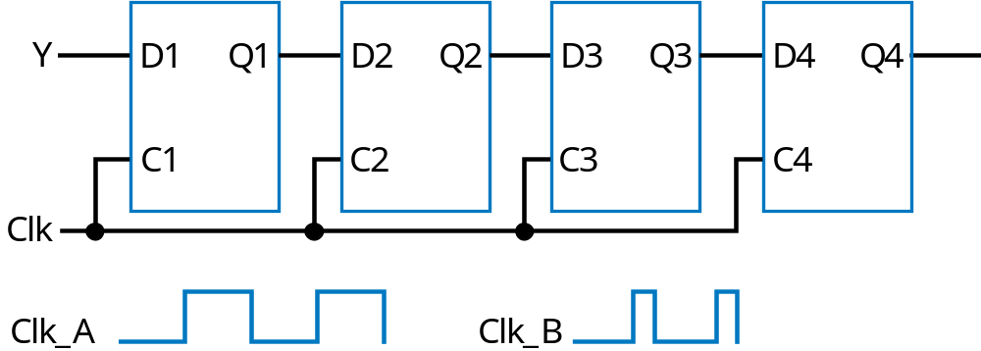
Problem With D Latches (1)
Consider the following system
What are the values for Q1, Q2, Q3, and Q4?
  They depend on how long Clk is!
    Clk_A – signal may travel through multiple latches
    Clk_B – signal may travel through fewer latches
1
1?
1?
1?

Slide 9
Problem with D Latches (2)
D latch
0–>1
D latch
D1
D2
0–>1
S1
0–>1
S2
0–>1
C1
C2
D3
Q3
D4
Q4
C3
C4
Q1
R2
Q2
R1
0–>1
1–>0
0–>1
1–>0
Clk
Long clock
Short clock
Clk
Clk
D1
D1
Q1/D2
Q1/D2
Q1 doesn't change
S2
S2
R2
R2
Q2
2nd latch set
Q2
Issue: Hard/not practical to get the clock signal “just right”

Slide 10
Idea
Can we design bit storage that only stores a value on the rising edge of a clock signal?
This way, it doesn’t matter how long the clock signal is
A flip-flop does exactly that!
rising edges
Clk

Slide 11
D Flip-Flops
Each D flip-flop contains
  2 D latches
  1 NOT gate
When C = 0
  Master is in transparent mode (storing data)
  Servant is in storage mode
When C = 1
  Master is in storage mode
  Servant is in transparent mode
So D flip-flops store data on clock edge
D flip-flop
D latch
D latch
D
Q
′
Dm
Qm
Ds
Qs
′
Cm
Cs
Qs
Q
master
se
r
v
ant
Clk

Slide 12
D Flip-Flops: More Details
Clk = 0
  Master enabled, loads D, appears at Qm
  Servant disabled
Clk = 1
  Master disabled, Qm stays same
  Servant latch enabled, loads Ds, appears at Qs
Thus, value at D (and hence at Qm) when Clk changes from 0 to 1 gets stored into servant
D flip-flop
D latch
D latch
D
Q
′
Dm
Qm
Ds
Qs
′
Cm
Cs
Qs
Q
master
se
r
v
ant
Clk
Clk
D/Dm
Cm
Qm/Ds
Cs
Qs

Slide 13
Why Are Flip-Flops Better Than Latches?
1
1
Signal travels through exactly one flip-flop, for Clk_A or Clk_B
Why?
  Because on rising edge of Clk, all four flip-flops are loaded simultaneously – then all four no longer pay attention to their input, until the next rising edge
  Doesn’t matter how long Clk is 1
Y
D1
Q1
D2
Q2
D3
Q3
D4
Q4
Two latches inside each flip-flop
Clk
Clk_A
Clk_B

Slide 14
D Latch vs. D Flip-Flop
Latch is level-sensitive
  Stores D when C=1
Flip-flop is edge triggered
  Stores D when C changes from 0 to 1
Saying “level-sensitive latch” or “edge-triggered flip-flop” is redundant
Clk
1
2
Latch follows D while Clk is 1
D
3
4
5
6
Flip-flop only loads D during Clk rising edge
Q (D latch)
7
8
Q (D flip-flop)
9
10

Slide 15
D Flip-Flops Summary (1)
D
Q
’
D
Q
’
The triangle means edge-triggered clock input
Q
Q
Symbol for rising-edge
triggered D flip-flop
Symbol for falling-edge
triggered D flip-flop
rising edges
falling edges
Clk
Clk

Slide 16
D Flip-Flops Summary (2)
C | D/Dm | Cm | Qm | Ds | Cs | Qs
0 | 0 | 1 | 0 | 0 | 0 | No change
0 | 1 | 1 | 1 | 1 | 0 | No change
1 | 0 | 0 | No change | 0 | 1 | 0
1 | 1 | 0 | No change | 1 | 1 | 1

Slide 17
D Flip-Flop: Simpler Truth Table
D | Q⁻ | Q | Note
0 | 0 | 0 | Reset
0 | 1 | 0 | Reset
1 | 0 | 1 | Set
1 | 1 | 1 | Set
D
Q
Q’
Q⁻ is the value for Q during the previous cycle

Slide 18
T Flip-Flop
Toggles output when set
T | Q | Q⁺ | Note
0 | 0 | 0 | Hold
0 | 1 | 1 | Hold
1 | 0 | 1 | Toggle
1 | 1 | 0 | Toggle
T
Q
Q’
Q⁺ is the value for Q during the next cycle

Slide 19
JK Flip-Flop
Very versatile, you can think of it as a combination of D flip-flop and T flip-flop
J | K | Q⁺ | Note
0 | 0 | Q | Hold
0 | 1 | 0 | Reset
1 | 0 | 1 | Set
1 | 1 | Q’ | Toggle
J
Q
Q’
K
Q⁺ is the value for Q during the next cycle

Slide 20
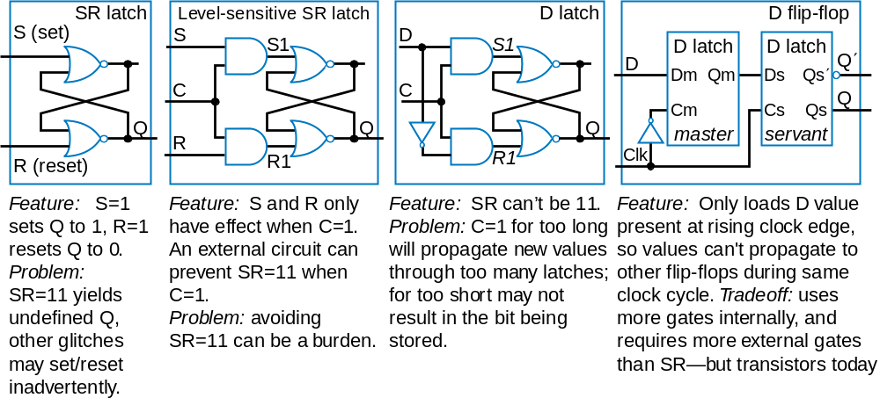
Bit Storage Summary

Slide 21
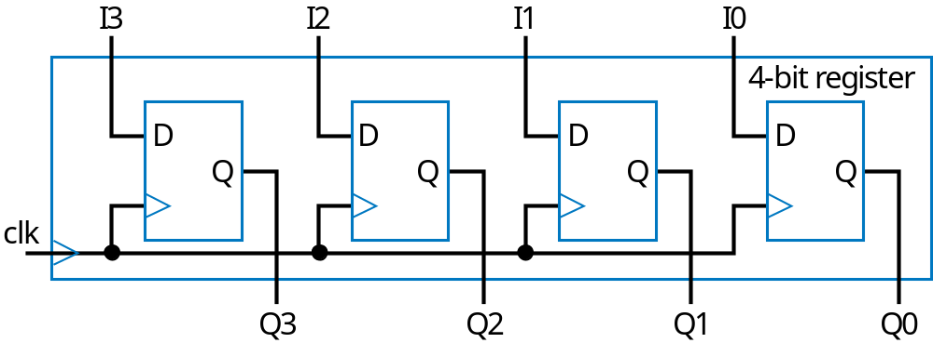
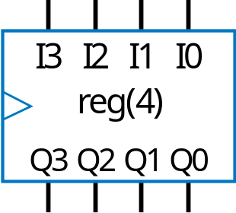
Basic Register
Typically, we store multi-bit items
  e.g., storing a 4-bit binary number
Register: multiple flip-flops sharing the same clock signal
  From this point, we’ll use registers for bit storage
    No need to think of latches or flip-flops
    But now you know what’s inside a register

Slide 22
Example: Attendance Records Display
Display shows the numbers of students in class as 5-bit binary numbers
Timer C pulses every day at 1:00pm
Record attendance on each pulse, display last three recorded values
Present
Yesterday
The day before yesterday
Attendance Today
Display
Display
Display
24
21
x4
a4
a3
a2
a1
a0
b4
b3
b2
b1
b0
c4
c3
c2
c1
c0
18
x3
x2
x1
AttendanceHistoryStorage
x0
timer
C

Slide 23
Example: Attendance Records Display
Use three 5-bit registers
24
a4
a3
a2
a1
a0
b4
b3
b2
b1
b0
c4
c3
c2
c1
c0
21
x4
I
4
Q4
I
4
Q4
I
4
Q4
18
x3
I
3
Q3
I
3
Q3
I
3
Q3
x2
I
2
Q2
I
2
Q2
I
2
Q2
x1
I
1
Q1
I
1
Q1
I
1
Q1
x0
I
0
Q0
I
0
Q0
I
0
Q0
C
R
a
R
b
R
c
AttendanceHistoryStorage
x4...x0
15
18
20
21
21
22
24
24
24
25
25
26
26
26
27
27
27
27
C
R
a
0
18
21
24
25
26
27
Note that registers are only loaded on rising clock edges
R
b
0
0
18
21
24
25
26
R
c
0
0
0
18
21
24
25

Slide 24
Today’s Objectives
To understand why latches are not suitable for data storage in a digital system
To become familiar with flip-flops and how they address the shortcomings of latches
To understand how to design and use a basic register

Slide 25
Question
What’s the clock frequency for the clock period of 0.2ns?

